Slide 1
LOWER SIXTH ARTS
GEOGRAPHY
Lesson 4
Vegetation of Cameroon
Notes:
Good morning, class, and welcome to our geography lesson. I am your geography teacher, Mr Kamdem. Today we are starting Lesson 4: Vegetation of Cameroon.

Slide 2
CLASS INFO
Class, Chapter and Duration
Class | Lower Sixth Arts
Chapter | Geography of Cameroon
Duration | 2 periods (2 × 50 minutes)
Notes:
This lesson is for Lower Sixth Arts. It belongs to Geography of Cameroon. We shall need 2 periods to cover it.

Slide 3
IDENTIFICATION
Lesson Identification
Topic | Geography of Cameroon
Sub-topic | The Physical Environment of Cameroon
Lesson | Lesson 4: Vegetation of Cameroon
Notions / Concepts | Vegetation, forest, savanna, mangrove, montane forest, forest reserve, domesticated landscape, desertification.
Syllabus focus | Forest vegetation types (mangrove, rainforest, montane and submontane) and forest reserves; grassland types (Guinea, Sudan, Sahel); domesticated landscapes; distribution, species, exploitation, threats and measures of each type.
Competence | Learners are able to describe the vegetation types of Cameroon, their exploitation and the measures needed to protect them.
Notes:
Our topic is Geography of Cameroon, and the sub-topic is The Physical Environment of Cameroon. The key notions we shall use today are: vegetation, forest, savanna, mangrove, montane forest, forest reserve, domesticated landscape, desertification. At the end, you should be able to do this: learners are able to describe the vegetation types of Cameroon, their exploitation and the measures needed to protect them.

Slide 4

HOMEWORK CORRECTION
Correction of the Homework
Question (Lesson 3: Soils of Cameroon):
Name the three types of savanna found in Cameroon.
Notes:
Before we start the new lesson, let us correct the homework I gave you at the end of Lesson 3: Soils of Cameroon. The question was: Name the three types of savanna found in Cameroon. Take out your exercise books.

Slide 5
HOMEWORK CORRECTION
Correction: Possible Answer
The Guinea savanna, the Sudan savanna and the Sahel savanna.
Notes:
Here is a good answer. The Guinea savanna, the Sudan savanna and the Sahel savanna. Compare it with your own answer and correct your work in red.

Slide 6
LESSON PLAN
Lesson Plan
Correction of the homework
Objectives and recall
Real-life situation and action to take
Learning activities
Board summary
Evaluation, remediation and homework
Notes:
Here is the plan of our lesson today. First, we shall correct the homework. Then we shall look at the objectives and recall what you already know. After that, we shall study a situation from real life and the action to take, and do the learning activities. Finally, we shall copy the board summary, do the evaluation and the remediation, and I will give you the homework.

Slide 7
OBJECTIVES
Objectives
By the end of this lesson, you should be able to:
Define vegetation, forest, savanna and domesticated landscape.
Describe the forest vegetation types of Cameroon.
Notes:
Take your time to copy this part; we will continue together.

Slide 8
OBJECTIVES
Objectives (continued)
Describe the grassland vegetation types of Cameroon.
Explain the threats to vegetation and the measures of protection.
Notes:
By the end of this lesson, you should be able to do four things. Number 1: define vegetation, forest, savanna and domesticated landscape. Number 2: describe the forest vegetation types of Cameroon. Number 3: describe the grassland vegetation types of Cameroon. Number 4: explain the threats to vegetation and the measures of protection.

Slide 9
PREVIOUS KNOWLEDGE
Previous Knowledge
Vegetation depends mainly on climate and soils.
The South is wet all year; the North has a long dry season.
Many trees around Garoua are cut for firewood and charcoal.
Notes:
Let us first remember what you already know. Vegetation depends mainly on climate and soils. The South is wet all year; the North has a long dry season. Many trees around Garoua are cut for firewood and charcoal. Keep this in mind, because we shall build on it today.

Slide 10
REAL-LIFE SITUATION
Situation in Real Life
One evening in Garoua you watch a documentary on the Dja Reserve: giant trees form a roof so dense that the ground is dark.
Outside your window you see golden grass with scattered acacias and baobabs.
"
Notes:
Listen carefully to this situation from real life. One evening in Garoua you watch a documentary on the Dja Reserve: giant trees form a roof so dense that the ground is dark. Outside your window you see golden grass with scattered acacias and baobabs. Your sister asks: "Why does Cameroon have such different vegetation, and how can we protect it?" Think about it, because I am going to ask you some questions.

Slide 11
REAL-LIFE SITUATION
Situation: Question 1
What is the problem in the situation?
Notes:
Question 1: What is the problem in the situation? Think for a moment, then raise your hand to answer.

Slide 12
REAL-LIFE SITUATION
Answer
The sister does not know why vegetation differs across Cameroon and how to protect it.
Notes:
Good. The sister does not know why vegetation differs across Cameroon and how to protect it.

Slide 13
REAL-LIFE SITUATION
Situation: Question 2
Describe the vegetation of the Dja Reserve.
Notes:
Question 2: Describe the vegetation of the Dja Reserve. Think for a moment, then raise your hand to answer.

Slide 14
REAL-LIFE SITUATION
Answer
A very dense forest of giant trees.
Notes:
Good. A very dense forest of giant trees.

Slide 15
REAL-LIFE SITUATION
Situation: Question 3
Describe the vegetation around Garoua.
Notes:
Question 3: Describe the vegetation around Garoua. Think for a moment, then raise your hand to answer.

Slide 16
REAL-LIFE SITUATION
Possible Answer
Grass with scattered trees such as acacias and baobabs (savanna).
Notes:
Good. Grass with scattered trees such as acacias and baobabs (savanna).

Slide 17
ACTION TO TAKE
Action to Take
Protect trees around your home and avoid bush fires.
Notes:
From this situation, the action we are working towards in this lesson is the following: protect trees around your home and avoid bush fires.

Slide 18
JUSTIFICATION
Justification of the Lesson
This lesson helps us to know the vegetation of Cameroon, its resources and the need to protect it.
Notes:
Why is this lesson important for you? This lesson helps us to know the vegetation of Cameroon, its resources and the need to protect it.

Slide 19

1. FOREST VEGETATION
Activity 1
The vegetation of Cameroon.
Notes:
Activity 1. Look carefully at this diagram: the vegetation of Cameroon. Observe every detail before I ask the question.

Slide 20
1. FOREST VEGETATION
Activity 1: Question
Which vegetation covers the south of Cameroon?
Notes:
Here is the question for Activity 1: Which vegetation covers the south of Cameroon? Take one minute to think and write your answer in your rough notebook.

Slide 21
1. FOREST VEGETATION
Activity 1: Answer
Dense rainforest.
Notes:
Let us check the answer together. Dense rainforest.

Slide 22

1. FOREST VEGETATION
Activity 2
Trees with stilt roots.
Notes:
Activity 2. Look carefully at this picture: trees with stilt roots. Observe every detail before I ask the question.

Slide 23
1. FOREST VEGETATION
Activity 2: Question
Where does this forest with stilt roots grow in Cameroon?
Notes:
Here is the question for Activity 2: Where does this forest with stilt roots grow in Cameroon? Take one minute to think and write your answer in your rough notebook.

Slide 24
1. FOREST VEGETATION
Activity 2: Answer
In the estuaries of the coast, such as the Wouri and the Rio del Rey (mangroves).
Notes:
Let us check the answer together. In the estuaries of the coast, such as the Wouri and the Rio del Rey (mangroves).

Slide 25

2. GRASSLAND VEGETATION
Activity 3
Grass with scattered trees.
Notes:
Activity 3. Look carefully at this picture: grass with scattered trees. Observe every detail before I ask the question.

Slide 26
2. GRASSLAND VEGETATION
Activity 3: Question
Which type of savanna surrounds Garoua?
Notes:
Here is the question for Activity 3: Which type of savanna surrounds Garoua? Take one minute to think and write your answer in your rough notebook.

Slide 27
2. GRASSLAND VEGETATION
Activity 3: Answer
The Sudan savanna.
Notes:
Let us check the answer together. The Sudan savanna.

Slide 28

2. GRASSLAND VEGETATION
Activity 4
Tree planting in a dry area.
Notes:
Activity 4. Look carefully at this picture: tree planting in a dry area. Observe every detail before I ask the question.

Slide 29
2. GRASSLAND VEGETATION
Activity 4: Question
Which threat does tree planting fight in the Far North?
Notes:
Here is the question for Activity 4: Which threat does tree planting fight in the Far North? Take one minute to think and write your answer in your rough notebook.

Slide 30
2. GRASSLAND VEGETATION
Activity 4: Answer
Desertification.
Notes:
Let us check the answer together. Desertification.

Slide 31

3. DOMESTICATED LANDSCAPES
Activity 5
Oil palms in rows.
Notes:
Activity 5. Look carefully at this picture: oil palms in rows. Observe every detail before I ask the question.

Slide 32
3. DOMESTICATED LANDSCAPES
Activity 5: Question
Is this natural vegetation? Why?
Notes:
Here is the question for Activity 5: Is this natural vegetation? Why? Take one minute to think and write your answer in your rough notebook.

Slide 33
3. DOMESTICATED LANDSCAPES
Activity 5: Answer
No: the trees were planted by people (a plantation).
Notes:
Let us check the answer together. No: the trees were planted by people (a plantation).

Slide 34
BOARD SUMMARY
Board Summary
Topic: Geography of Cameroon
Sub-topic: The Physical Environment of Cameroon
Lesson 4: Vegetation of Cameroon
Notes:
Now we are going to copy the board summary. Write the title and the headings neatly in your notebooks. I will give you enough time for each slide, so do not rush.

Slide 35
BOARD SUMMARY
DEFINITIONS
The key terms of this lesson are defined as follows:
Vegetation: It is the plant cover of an area.
Forest: It is a vegetation dominated by trees whose crowns touch.
Notes:
Let us copy the definitions. The key terms of this lesson are defined as follows. On this slide we have Vegetation and Forest. Write each point on a new line, with the key term first, and explain it in your own words when we revise. When you finish, we go to the next slide.

Slide 36
BOARD SUMMARY
DEFINITIONS (continued)
Savanna: It is a tropical grassland with scattered trees and shrubs.
Forest reserve: It is a forest protected by the state, where cutting trees is controlled or forbidden.
Notes:
We continue with the definitions. On this slide we have Savanna and Forest reserve. Write each point on a new line, with the key term first, and explain it in your own words when we revise. When you finish, we go to the next slide.

Slide 37
BOARD SUMMARY
DEFINITIONS (continued)
Domesticated landscape: It is an area where natural vegetation has been replaced by vegetation planted by people.
Notes:
We continue with the definitions. On this slide we have Domesticated landscape. Write each point on a new line, with the key term first, and explain it in your own words when we revise.

Slide 38
BOARD SUMMARY
1. Forest Vegetation Types
A) Mangrove Forests
Mangrove forests are presented as follows:
Distribution: They grow in the estuaries and creeks of the coast: Rio del Rey, the Cameroon (Wouri) estuary and the Ntem mouth.
Illustration: mangroves
Notes:
Let us copy Mangrove Forests. Mangrove forests are presented as follows. Copy the point on Distribution on the left, then draw the diagram on the right: mangroves. Give it a title and label it clearly.

Slide 39
BOARD SUMMARY
1. Forest Vegetation Types
A) Mangrove Forests
Species and characteristics: Salt-tolerant trees such as Rhizophora (with stilt roots) and Avicennia (with breathing roots) grow in muddy, salty water.
Notes:
We continue with Mangrove Forests. On this slide we have Species and characteristics. Write each point on a new line, with the key term first, and explain it in your own words when we revise. When you finish, we go to the next slide.

Slide 40
BOARD SUMMARY
1. Forest Vegetation Types
A) Mangrove Forests (continued)
Exploitation: People cut them for fuelwood (especially to smoke fish), poles and fishing; they are breeding grounds for fish and shrimps.
Threats: Cutting for fuelwood, the growth of Douala, pollution and oil activities.
Notes:
We continue with Mangrove Forests. On this slide we have Exploitation and Threats. Write each point on a new line, with the key term first, and explain it in your own words when we revise. When you finish, we go to the next slide.

Slide 41
BOARD SUMMARY
1. Forest Vegetation Types
A) Mangrove Forests (continued)
Measures: Protection in the Douala-Edéa National Park, replanting and improved fish-smoking ovens.
Notes:
We continue with Mangrove Forests. On this slide we have Measures. Write each point on a new line, with the key term first, and explain it in your own words when we revise.

Slide 42
BOARD SUMMARY
1. Forest Vegetation Types
B) The Equatorial Rainforest
The rainforest is presented as follows:
Distribution: It covers the South, East, Centre, Littoral and South-West, about 20 million hectares.
Illustration: the vegetation of Cameroon
Notes:
Let us copy The Equatorial Rainforest. The rainforest is presented as follows. Copy the point on Distribution on the left, then draw the diagram on the right: the vegetation of Cameroon. Give it a title and label it clearly.

Slide 43
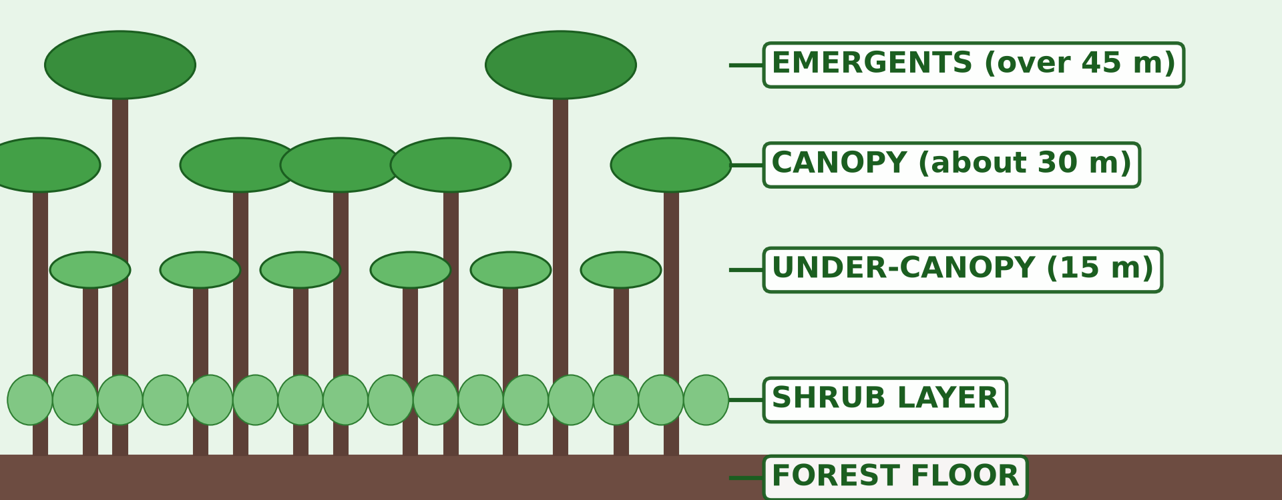
BOARD SUMMARY
1. Forest Vegetation Types
B) The Equatorial Rainforest
Characteristics: It is a dense, evergreen, broad-leaved forest in layers, with emergent trees up to 50–60 m, lianas and little undergrowth.
Illustration: the layers of the rainforest
Notes:
Copy the point on Characteristics on the left, then draw the diagram on the right: the layers of the rainforest. Give it a title and label it clearly.

Slide 44
BOARD SUMMARY
1. Forest Vegetation Types
B) The Equatorial Rainforest
Species: Valuable hardwoods include sapele, iroko, ayous, moabi, azobé, ebony and mahogany.
Notes:
We continue with The Equatorial Rainforest. On this slide we have Species. Write each point on a new line, with the key term first, and explain it in your own words when we revise. When you finish, we go to the next slide.

Slide 45
BOARD SUMMARY
1. Forest Vegetation Types
B) The Equatorial Rainforest (continued)
Exploitation: Timber logging (especially in the East), fuelwood, and non-timber products such as eru, bush mango and medicinal plants.
Threats: Logging, shifting cultivation, plantations, mining and poaching.
Notes:
We continue with The Equatorial Rainforest. On this slide we have Exploitation and Threats. Write each point on a new line, with the key term first, and explain it in your own words when we revise. When you finish, we go to the next slide.

Slide 46
BOARD SUMMARY
1. Forest Vegetation Types
B) The Equatorial Rainforest (continued)
Measures: Protected areas such as the Dja Reserve (a UNESCO World Heritage Site), Lobéké, Campo-Ma'an and Korup, the forestry law and community forests.
Notes:
We continue with The Equatorial Rainforest. On this slide we have Measures. Write each point on a new line, with the key term first, and explain it in your own words when we revise.

Slide 47

BOARD SUMMARY
1. Forest Vegetation Types
C) Montane and Submontane Forests
Montane and submontane forests are presented as follows:
Distribution: They grow on high mountains: Mount Cameroon, Mount Oku (Kilum-Ijim forest), the Bamboutos and Mount Manengouba.
Illustration: the Bamenda Highlands
Notes:
Let us copy Montane and Submontane Forests. Montane and submontane forests are presented as follows. Copy the point on Distribution on the left, then draw the diagram on the right: the Bamenda Highlands. Give it a title and label it clearly.

Slide 48
BOARD SUMMARY
1. Forest Vegetation Types
C) Montane and Submontane Forests
Characteristics: Submontane forest grows on the lower slopes, then montane forest with smaller trees, tree ferns and mosses, and grassland near the summits.
Notes:
We continue with Montane and Submontane Forests. On this slide we have Characteristics. Write each point on a new line, with the key term first, and explain it in your own words when we revise. When you finish, we go to the next slide.

Slide 49
BOARD SUMMARY
1. Forest Vegetation Types
C) Montane and Submontane Forests (continued)
Species: Prunus africana (pygeum), Podocarpus, tree ferns and many rare birds and plants.
Exploitation: Bark of Prunus africana for medicine, farming, grazing and fuelwood.
Notes:
We continue with Montane and Submontane Forests. On this slide we have Species and Exploitation. Write each point on a new line, with the key term first, and explain it in your own words when we revise. When you finish, we go to the next slide.

Slide 50
BOARD SUMMARY
1. Forest Vegetation Types
C) Montane and Submontane Forests (continued)
Threats and measures: Farming, grazing and bush fires destroy them; Mount Cameroon National Park and community forests (Kilum-Ijim) protect them.
Notes:
We continue with Montane and Submontane Forests. On this slide we have Threats and measures. Write each point on a new line, with the key term first, and explain it in your own words when we revise.

Slide 51
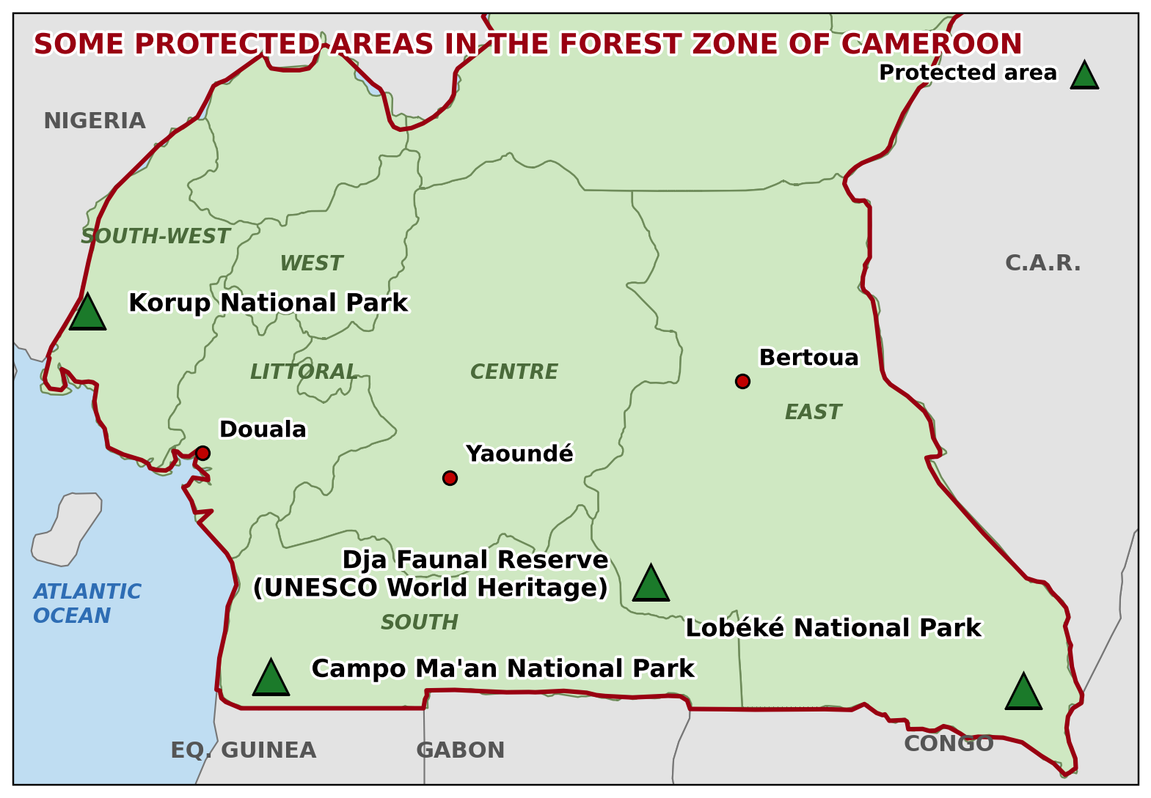
BOARD SUMMARY
1. Forest Vegetation Types
D) Forest Reserves
The types, examples and purpose of forest reserves are the following:
Types: National parks, wildlife reserves, forest reserves and community forests.
Illustration: protected areas of the forest zone
Notes:
Let us copy Forest Reserves. The types, examples and purpose of forest reserves are the following. Copy the point on Types on the left, then draw the diagram on the right: protected areas of the forest zone. Give it a title and label it clearly.

Slide 52
BOARD SUMMARY
1. Forest Vegetation Types
D) Forest Reserves
Examples: The Dja Faunal Reserve, the Lobéké, Campo-Ma'an and Korup National Parks, and the Mbalmayo Forest Reserve.
Purpose: They protect biodiversity, water sources and soils, and support research and tourism.
Notes:
We continue with Forest Reserves. On this slide we have Examples and Purpose. Write each point on a new line, with the key term first, and explain it in your own words when we revise.

Slide 53
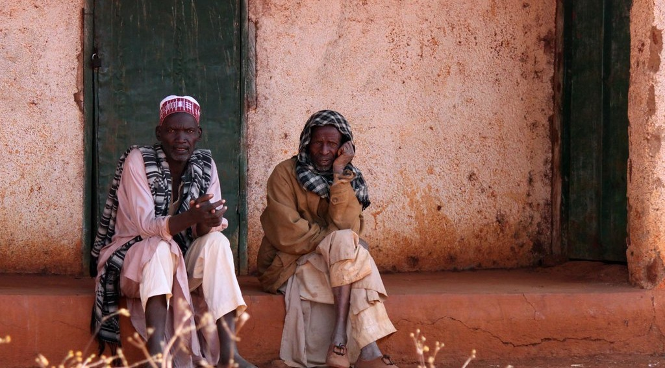
BOARD SUMMARY
2. Grassland Vegetation Types
A) The Guinea Savanna
The Guinea savanna is presented as follows:
Distribution: It covers the Adamawa Plateau and the north of the Centre and East Regions.
Illustration: the Adamawa Plateau
Notes:
Let us copy The Guinea Savanna. The Guinea savanna is presented as follows. Copy the point on Distribution on the left, then draw the diagram on the right: the Adamawa Plateau. Give it a title and label it clearly.

Slide 54
BOARD SUMMARY
2. Grassland Vegetation Types
A) The Guinea Savanna
Characteristics and species: Tall grasses (up to 3 m) with many trees such as Daniellia oliveri and Lophira lanceolata, and gallery forests along rivers.
Exploitation: Cattle grazing, farming of maize, yams and cassava, and fuelwood.
Notes:
We continue with The Guinea Savanna. On this slide we have Characteristics and species and Exploitation. Write each point on a new line, with the key term first, and explain it in your own words when we revise. When you finish, we go to the next slide.

Slide 55
BOARD SUMMARY
2. Grassland Vegetation Types
A) The Guinea Savanna (continued)
Threats and measures: Bush fires and overgrazing degrade it; controlled early burning, ranching and parks such as Mbam et Djerem protect it.
Notes:
We continue with The Guinea Savanna. On this slide we have Threats and measures. Write each point on a new line, with the key term first, and explain it in your own words when we revise.

Slide 56
BOARD SUMMARY
2. Grassland Vegetation Types
B) The Sudan Savanna
The Sudan savanna is presented as follows:
Distribution: It covers the Benue plain and the North Region, around Garoua.
Illustration: the Sudan savanna
Notes:
Let us copy The Sudan Savanna. The Sudan savanna is presented as follows. Copy the point on Distribution on the left, then draw the diagram on the right: the Sudan savanna. Give it a title and label it clearly.

Slide 57
BOARD SUMMARY
2. Grassland Vegetation Types
B) The Sudan Savanna
Characteristics and species: Shorter grasses (1–2 m) with scattered drought-resistant trees: shea (karité), locust bean (néré), baobab, tamarind and acacias.
Notes:
We continue with The Sudan Savanna. On this slide we have Characteristics and species. Write each point on a new line, with the key term first, and explain it in your own words when we revise. When you finish, we go to the next slide.

Slide 58
BOARD SUMMARY
2. Grassland Vegetation Types
B) The Sudan Savanna (continued)
Exploitation: Cotton and food farming, grazing, shea butter and fuelwood and charcoal for towns such as Garoua.
Notes:
We continue with The Sudan Savanna. On this slide we have Exploitation. Write each point on a new line, with the key term first, and explain it in your own words when we revise. When you finish, we go to the next slide.

Slide 59
BOARD SUMMARY
2. Grassland Vegetation Types
B) The Sudan Savanna (continued)
Threats and measures: Tree cutting, bush fires and overgrazing; the Bénoué, Bouba Ndjida and Faro National Parks and reforestation protect it.
Notes:
We continue with The Sudan Savanna. On this slide we have Threats and measures. Write each point on a new line, with the key term first, and explain it in your own words when we revise.

Slide 60
BOARD SUMMARY
2. Grassland Vegetation Types
C) The Sahel Savanna
The Sahel savanna is presented as follows:
Distribution: It covers the Far North, north of about 11° N, towards Lake Chad.
Notes:
Let us copy The Sahel Savanna. The Sahel savanna is presented as follows. On this slide we have Distribution. Write each point on a new line, with the key term first, and explain it in your own words when we revise. When you finish, we go to the next slide.

Slide 61
BOARD SUMMARY
2. Grassland Vegetation Types
C) The Sahel Savanna (continued)
Characteristics and species: Short, sparse grasses and thorny shrubs: acacias (including the gum arabic tree), doum palms and Balanites.
Exploitation: Pastoralism, gum arabic and fuelwood.
Notes:
We continue with The Sahel Savanna. On this slide we have Characteristics and species and Exploitation. Write each point on a new line, with the key term first, and explain it in your own words when we revise.

Slide 62
BOARD SUMMARY
2. Grassland Vegetation Types
C) The Sahel Savanna
Threats and measures: Drought, overgrazing and tree cutting cause desertification; Operation Sahel Vert, the Great Green Wall and the Waza National Park protect it.
Illustration: tree planting in the Sahel
Notes:
Copy the point on Threats and measures on the left, then draw the diagram on the right: tree planting in the Sahel. Give it a title and label it clearly.

Slide 63
BOARD SUMMARY
3. Domesticated Landscapes
The examples, importance and problems of domesticated landscapes are the following:
Examples: Plantations of oil palm, rubber and bananas (CDC, SOCAPALM), tea estates (Tole, Ndu), cocoa agroforests and eucalyptus in the Western Highlands.
Illustration: an oil palm plantation
Notes:
Let us copy Domesticated Landscapes. The examples, importance and problems of domesticated landscapes are the following. Copy the point on Examples on the left, then draw the diagram on the right: an oil palm plantation. Give it a title and label it clearly.

Slide 64
BOARD SUMMARY
3. Domesticated Landscapes
Importance: They provide food, raw materials, jobs and income.
Problems: They reduce natural forests and biodiversity.
Notes:
We continue with Domesticated Landscapes. On this slide we have Importance and Problems. Write each point on a new line, with the key term first, and explain it in your own words when we revise.

Slide 65
FORMATIVE EVALUATION
Evaluation 1
Name the three types of savanna in Cameroon from south to north.
Notes:
Now let us check what you have understood. Question 1: Name the three types of savanna in Cameroon from south to north. Answer in your exercise book.

Slide 66
FORMATIVE EVALUATION
Expected Answer
The Guinea, the Sudan and the Sahel savanna.
Notes:
The expected answer is: the Guinea, the Sudan and the Sahel savanna. If you got it right, well done.

Slide 67
FORMATIVE EVALUATION
Evaluation 2
Give two threats to the rainforest.
Notes:
Now let us check what you have understood. Question 2: Give two threats to the rainforest. Answer in your exercise book.

Slide 68
FORMATIVE EVALUATION
Expected Answer
Logging and shifting cultivation (also mining and plantations).
Notes:
The expected answer is: logging and shifting cultivation (also mining and plantations). If you got it right, well done.

Slide 69
REMEDIATION
Remediation
Fill in the blanks:
Salt-tolerant forests of estuaries are ______ forests.
The Dja Reserve is a UNESCO World ______ Site.
Notes:
Take your time to copy this part; we will continue together.

Slide 70
REMEDIATION
Remediation (continued)
The spread of desert conditions in the Far North is called ______.
Notes:
For those who need more practice, fill in the blanks in your exercise book. The answers are: number 1, mangrove; number 2, Heritage; number 3, desertification.

Slide 71
HOMEWORK
Homework
Name the four drainage basins of Cameroon.
Notes:
For your homework: Name the four drainage basins of Cameroon. We shall correct it at the beginning of our next lesson.

Slide 72
NEXT LESSON
Next Lesson
Our next lesson will be on:
Lesson 5: The Drainage of Cameroon
Notes:
Our next lesson will be on Lesson 5: The Drainage of Cameroon. Thank you for your attention, and see you next time.

Slide 73
BILINGUAL GAME
Bilingual Game (Jeu Bilingue)
English | Français
Vegetation | La végétation
Forest | La forêt
Savanna | La savane
Mangrove | La mangrove
Bush fire | Le feu de brousse
Reserve | La réserve
Plantation | La plantation
Desertification | La désertification
Notes:
Let us play the bilingual game. I say a word in English, and you give me the French word. Then we do the reverse.

Slide 74
LOGBOOK
Official Logbook (1/2)
Module / Topic | Geography of Cameroon
Lesson Title | Lesson 4: Vegetation of Cameroon
Expected Learning Outcomes | Define vegetation, forest, savanna and domesticated landscape. Describe the forest vegetation types of Cameroon. Describe the grassland vegetation types of Cameroon. Explain the threats to vegetation and the measures of protection.
Competence | Learners are able to describe the vegetation types of Cameroon, their exploitation and the measures needed to protect them.
Notes:
I record this information in the official logbook of the class after the lesson.

Slide 75
LOGBOOK
Official Logbook (2/2)
Matter Taught | DEFINITIONS; Mangrove Forests; The Equatorial Rainforest; Montane and Submontane Forests; Forest Reserves; The Guinea Savanna; The Sudan Savanna; The Sahel Savanna; Domesticated Landscapes.
Evaluation | Formative evaluation and remediation exercise.
Homework | Name the four drainage basins of Cameroon.
Enrolment / Present / Absent | ____ / ____ / ____
Achievement | To be completed after the lesson.
Notes:
I complete the second page of the logbook: the matter taught, the evaluation, the homework and the attendance.

Slide 76
TEACHER'S NOTE
Teacher's Note
Timing: Homework correction, plan, objectives 8 min | Recall, situation, action 10 min | 5 activities 30 min | Board summary (copying) 30 min | Evaluation, remediation 10 min | Homework, next lesson 5 min | Logbook 7 min
Without the projector (Activity 1): shade the vegetation zones on a sketch map.
Without the projector (Activity 2): show the coast on a map.
Without the projector (Activity 3): describe the vegetation around the school.
Without the projector (Activity 4): name tree-planting projects.
Without the projector (Activity 5): name plantations of Cameroon.
Notes:
This slide is for me, the teacher: it gives the timing of the lesson and what to do if the projector is not available.

Slide 77
REFERENCES
References
Geography Syllabus for Sixth Forms (Lower and Upper Sixth), MINESEC, 2019 — Geography of Cameroon.
Teacher's course notes: Mr KAMDEM E., Cameroon Geography (LSA), GBHS Garoua, 2026.
Photo, Activity 2: “Pitchavaram waterway - Mangrove forest” by Balaji.B Photography, CC BY 2.0, via Flickr (https://www.flickr.com/photos/81073027@N00/1745978833)
Photo, Activity 3: “Blue Wildebeest in the Lowveld” by Martin_Heigan, CC BY-NC-ND 2.0, via Flickr (https://www.flickr.com/photos/97303475@N00/2089079933)
Photo, Activity 4: “Nyando Climate Smart Villages Media Visit” by CGIAR Climate, CC BY-NC-SA 2.0, via Flickr (https://www.flickr.com/photos/55227776@N04/9720026817)
Photo, Activity 5: “Aerial view of oil palm plantation” by CIFOR, CC BY-NC-ND 2.0, via Flickr (https://www.flickr.com/photos/45423546@N07/38802487905)
Photo, board summary (Distribution): “Bamenda, Cameroon” by jbdodane, CC BY-NC 2.0, via Flickr (https://www.flickr.com/photos/27998473@N02/11293877215)
Notes:
Take your time to copy this part; we will continue together.

Slide 78
REFERENCES
References (continued)
Photo, board summary (Distribution): “At Dang and its livestock market” by 10b travelling / Carsten ten Brink, CC BY-NC-ND 2.0, via Flickr (https://www.flickr.com/photos/77334245@N00/7311224966)
Diagrams and animations: drawn for this lesson (Geography Department).
Notes:
These are the references and picture credits used to prepare this lesson.

